Slide 1


TAILWIND Banks
Submitted by -
Submitted to -
Saurav Singh
Shreyasi Gour
Yash Gupta
MR. Sunil Verma
INVEST IN YOUR FUTURE

Slide 2
The word ‘Bank’ has been derived from the Latin word ‘bancus’ or ‘banque’. The meaning of it in English is a bench.
According to some authorities, the word bank was originally derived from German word bank. It means a joint stock fund.
This word later on was called as ‘banco’ in Italy when a great part of Italy was ruled by the Germans.
The Indian Banking Companies Act, 1949 :
“Banking means the acceptance for the purpose of lending or investment, of deposits of money from the public repayable on demand or otherwise, and withdrawal by cheque, draft, order or otherwise”.
INTRODUCTION

Slide 3
Agency Houses
Presidency Banks
Joint Stock Banks
Stages in the Evolution of Banking in India :
Imperial Bank of India
Establishment of the Reserve Bank of India
Nationalisation of the RBI and the Banking Regulation Act
Nationalisation of Banks in 1969 and 1980

Slide 4
Agency houses:
With the advent of the East India Company, India was a global trade destination for a number of commodities including cotton, silk, indigo, saltpetre and tea.
In order to trade these commodities with global markets, European traders needed banks to finance foreign trade. Indigenous bankers in India did not provide this particular banking function and hence the East India Company diversified its business by introducing agency houses in Calcutta which amongst others also performed banking functions.
These agency houses performed all the banking functions of receiving deposits, making advances and issuing paper money. Their responsibility of note circulation crucially helped them in carrying out their diversified lines of businesses as ship-owners, land owners, farmers, manufacturers, money lenders and bankers (Cooke, 1830). It was the agency house of Messrs. Alexander & Co. which started the first European bank in India, called the Bank of Hindostan, in 1770 (Singh, 1966). Later on, many banks were established. But they disappeared as fast as they were born. Anybody could then start a bank. The field was free for all.
Stages in the Evolution of Banking in India :

Slide 5
Presidency Banks
The East India Company(Europeans) took initiative in establishing Presidency Banks by contributing 20% of their share capital to meet its own demand for funds. The Presidency Banks were the Bank of Bengal, established on 2 June 1806, the Bank of Bombay (incorporated on 15 April 1840), and the Bank of Madras (incorporated on 1 July 1843).
Joint Stock Banks
The Presidency banks, namely Bank of Bengal, Bank of Madras and Bank of Bombay, were established by the East India Company more than a century ago with a view to manage its finances in the country and also lend money to the Indian mercantile class. However, these banks (managed by the Brits) were not comfortable lending money to Indian businessmen, mainly because they found it difficult to understand the `HUF-way' (Hindu Undivided Family) of doing business. By the turn of the century, many banks with the initiative of Indians were established. Punjab National Bank, Allahabad Bank, Bank of Baroda are some of the banks then established. Many foreigners also came in the field of Indian banking.
Stages in the Evolution of Banking in India :

Slide 6

Imperial bank of India
The Imperial Bank of India came into existence on 27 January 1921 through the reorganisation and amalgamation of the three Presidency Banks of colonial India into a single banking entity.
The Imperial Bank was 80% privately owned while the rest were owned by the state.
The Imperial Bank of India (IBI) was one of the oldest and the largest commercial bank of the Indian subcontinent, and was subsequently transformed into the State Bank of India in 1955. Initially, as per its royal charter, it acted as the central bank for British India prior to the formation of the Reserve Bank of India in 19350.
Seal of IBI--
Stages in the Evolution of Banking in India :

Slide 7

Establishment of RBI
Though there was boom in banking, due to absence of any regulation and facility of timely assistance there were recurrent bank failures. This resulted in suspicion about banks in the minds of the people. They stayed away from banks.
The need for a separate Central Bank was emphasised by Royal Commission(also known as Hilton-Young Commission) on Indian Currency and Finance – recommended the creation of a central bank for India to separate the control of currency and credit from the Government and to augment banking facilities throughout the country.
Accordingly, the RBI was established in 1935 to perform all the functions of a Central Bank. It was modelled on the pattern of the Bank of England. But it did not have much power of regulation. The period was also critical one due to the great depression and the subsequent Second World War. The RBI could not do much about banking.
Seal of RBI--
Stages in the Evolution of Banking in India :

Slide 8
Nationalisation of the RBI and the Banking Regulation Act
These two important steps were taken in 1949. Immediately after independence wide powers of regulation and control were given to the RBI and by making use of those powers the RBI was successful in making Indian banking trustworthy. The Act provides a framework under which commercial banking in India is supervised and regulated.Soon, bank failures became a thing of the past and India’s banks progressed under the guidance of the RBI. Many malpractices, deficiencies and drawbacks were sought to be removed by the RBI.
In 1965, the Act was amended to include cooperative banks under its purview by adding the Section 56. Cooperative banks, which operate only in one state, are formed and run by the state government. But, RBI controls the licensing and regulates the business operations.
Stages in the Evolution of Banking in India :

Slide 9
Nationalisation of Banks in 1969 and 1980
In 1969 the Indian government Nationalised 14 major private banks; one of the big banks was Bank of India. In 1980, 6 more private banks were nationalised. These nationalised banks are the majority of lenders in the Indian economy. They dominate the banking sector because of their large size and widespread networks.
Indian banks are now being prepared to become international players.
These are the stages through which Indian banking developed.
Stages in the Evolution of Banking in India :

Slide 10
1. Dealing in Money
Bank is a financial institution which deals with other people's money i.e. money given by depositors.
2. Individual / Firm / Company
A bank may be a person, firm or a company. A banking company means a company which is in the business of banking.
3. Acceptance of Deposit
A bank accepts money from the people in the form of deposits which are usually repayable on demand or after the expiry of a fixed period. It gives safety to the deposits of its customers. It also acts as a custodian of funds of its customers.
4. Giving Advances
A bank lends out money in the form of loans to those who require it for different purposes.
5. Payment and Withdrawal
A bank provides easy payment and withdrawal facility to its customers in the form of cheques and drafts, It also brings bank money in circulation. This money is in the form of cheques, drafts, etc.
Characteristics / Features of Bank :

Slide 11
6. Agency and Utility Services
A bank provides various banking facilities to its customers. They include general utility services and agency services.
7. Profit and Service Orientation
A bank is a profit seeking institution having service oriented approach.
8. Ever increasing Functions
Banking is an evolutionary concept. There is continuous expansion and diversification as regards the functions, services and activities of a bank.
9. Connecting Link
A bank acts as a connecting link between borrowers and lenders of money. Banks collect money from those who have surplus money and give the same to those who are in need of money.
10. Banking Business
A bank's main activity should be to do business of banking which should not be subsidiary to any other business.
Characteristics / Features of Bank :

Slide 12
11. Name Identity
A bank should always add the word "bank" to its name to enable people to know that it is a bank and that it is dealing in money.
Characteristics / Features of Bank :

Slide 13
Banks make it far easier for a complex economy to carry out the extraordinary range of transactions that occur in goods, labor, and financial capital markets. Imagine for a moment what the economy would be like if all payments had to be made in cash. When shopping for a large purchase or going on vacation you might need to carry hundreds of dollars in a pocket or purse. Even small businesses would need stockpiles of cash to pay workers and to purchase supplies. A bank allows people and businesses to store this money in either a checking account or savings account, for example, and then withdraw this money as needed through the use of a direct withdrawal, writing a check, or using a debit card.
Banks provide funds for business as well as personal needs of individuals. They play a significant role in the economy of a nation.
It encourages savings habit amongst people and thereby makes funds available for productive use.
Role of Banking

Slide 14
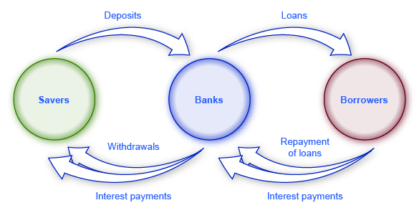
It acts as an intermediary between people having surplus money and those requiring money for various business activities.
It facilitates business transactions through receipts and payments by cheques instead of currency.
Role of Banking

Slide 15
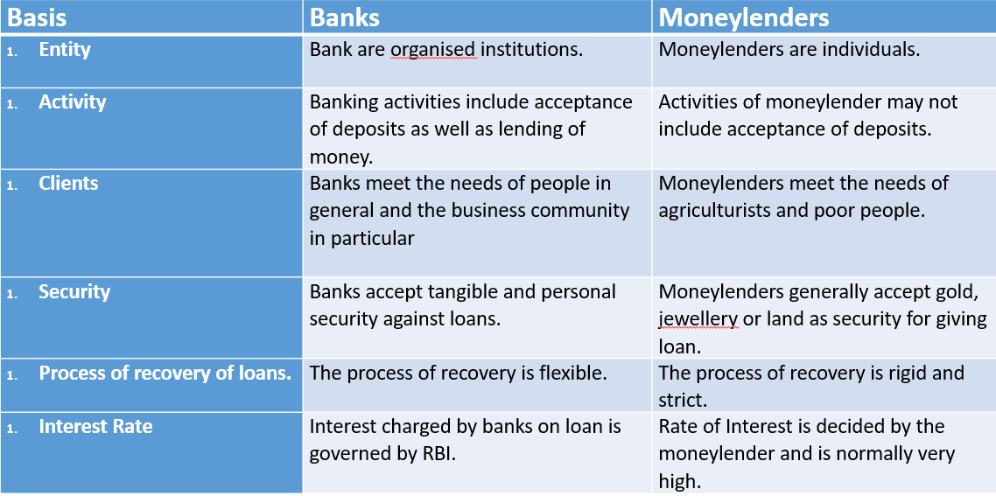
Distinction between banks and moneylenders

Slide 16


















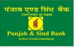









CAN
U
Guess Me?
INDIAN BANKING SYSTEM
Notes:
Slide depicts all the banks which comes under Indian Banking structure.

Slide 17

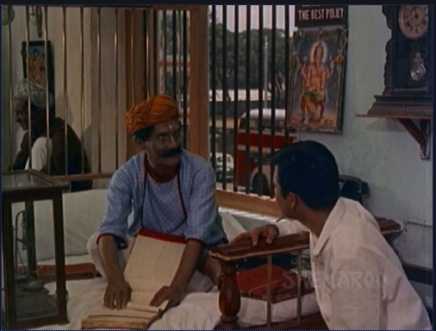
BANKING IN INDIA
Organized Banking
Un-Organized Banking
BANKING IN INDIA IN
PRE-INDEPENDENCE ERA
Commercial Banks
Agriculture Banks
Industrial Banks
Indigenous Banks
Chettiars of Market Street
Notes:
Before the Reserve Bank of India Act, 1939

Slide 18
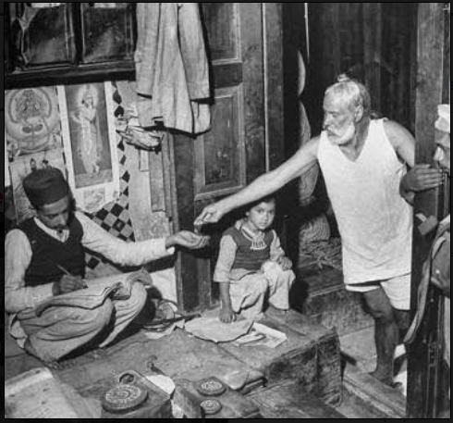

INDIGENOUS Banking
Characteristics of Indigenous Bankers
They use their own funds for lending activity. Deposits accepted from the public form only a small part of their working capital.
There are very few formalities in their operations part.
They are flexible in their working hours & also their establishments are small and economical, which makes them accessible to small and poor borrowers.
They provide prompt and personalized services without undue delay.
They rely more on the information they obtain from the borrowers through personal contacts that they maintain. They get information pertaining to the past history, business and financial position of the borrower. They also keep a close watch on the activities of the borrower.
Their operating costs are lower than those of commercial banks.
It’s a constituent of Non-Institutional Credit Agencies.
According to Indian Central Banking Enquiry Committee (1931) an indigenous banker is defined as "Any individual or private firm receiving deposits and dealing in hundis or lending money“
WHAT IS A HUNDI? Technically, a Hundi is an unconditional order in writing made by a person directing another to pay a certain sum of money to a person named in the order. Hundis, being a part of the informal system have no legal status and are not covered under the Negotiable Instruments Act, 1881.
INDIGENOUS Bankers
From very ancient days, indigenous banking is different from the modern western banking. It has been organized in the form of family or individual business. They have been called by various names in different parts of the country as Shroffs, Sethus, Sahukars, Mahajans, Chettis and so on. They vary in their size from petty money lenders substantial shroffs.

Slide 19
Scheduled Banks of India
Scheduled Commercial Banks
Scheduled Cooperative Banks
Public-Sector Banks(27)
Private-Sector Banks()
Foreign Banks()
Regional Rural Banks()
Scheduled Urban Cooperative Banks()
Scheduled State Cooperative Banks()
Nationalized Banks(19)
Old Private Banks()
SBI & its Associates(7)
New Private Banks()
Notes:
On the basis of Reserve Bank of India Act, 1939

Slide 20
SCHEDULED BANKS Scheduled Banks are those banks
Which are included in the second schedule of RBI Act,1934.
Which have a paid up capital & reserves of aggregate value of NOT LESS THAN RS.5 LAKHS.
RBI has FULL control over these banks. They can borrow from the RBI for Normal Banking purposes also.
All Commercial Banks, Regional Rural Banks, Foreign Banks are scheduled banks.
SCHEDULED BANKS OF INDIA
On the basis of Schedule under the Reserve Bank of India Act, 1934, banks were classified as scheduled banks & non-scheduled banks.
WHAT IS 2nd SCHEDULE in RBI ACT 1934? 2nd Schedule of the RBI Act,1934 contains the list of Scheduled Commercial Banks. The two basic conditions for a bank to be a Scheduled Commercial Bank are:-
The Paid Up Capital of the bank should be 5 lakh and above.
The bank should work in the interest of depositors.
NON-SCHEDULED BANKS Non-Scheduled banks are those banks
Which aren’t included in the second schedule of RBI Act,1934.
Which have a paid up capital & reserves of aggregate value LESS THAN RS.5 LAKHS.
RBI has NO specific control over these banks. Hence, they aren’t entitled to borrow from the RBI for Normal banking purposes under in emergency or “abnormal circumstances."
Jammu & Kashmir Bank is a non-scheduled bank.
Notes:
Scheduled Banks of India ; Types of scheduled BOI ; 2nd Schedule under RBI act

Slide 21
Parameter of Comparison | Scheduled Banks | Non-Scheduled Banks
Reserve Requirements | These are banking institutions that have no less than 5 lakh rupees in their reserves. | Their reserves are less than the mandatory 5 lakh rupees.
Safety and Security | They are generally more financially sound and unlikely to harm the interests and welfare of the depositors. | These banks are riskier to do business with.
Meaning | Scheduled banks are those that are listed and governed by the rules that are prescribed in the Reserve bank of India Act of 1934 | The non-scheduled banks are those that are exempt from the rules that govern the stronger financial institutions in India.
Cash Reserve Ratio | Maintained with Reserve Bank of India. | Each bank takes it upon itself to maintain the cash reserve ratio.
Borrowing | They are allowed to borrow money from the Reserve Bank of India for the purposes of undertaking regular banking activities. | Do not qualify to borrow any loans from the Reserve Bank of India. If they have to, they do so from other like-minded banks.
Returns | Are mandated to file their returns with the Reserve Bank of India periodically, preferably once a year. | No such provision exists. However, they have to publish and submit their returns to the shareholders and stock exchange where they are listed
SCHEDULED BANKS OF INDIA AT A GLANCE

Slide 22

Characteristics of Reserve Bank of India:
RBI as a Monetary Authority of India
RBI works as a monetary Authority of India. Monetary policy used to control the money supply in the economy. Policy review is being done quarterly, started from April and followed by July, October and January.
RBI – Issuer of Currency
Under Section 22 of RBI Act, 1934, Reserve Bank of India has the sole right to issue bank notes of all denominations. The first paper notes were issued by the private banks such as Bank of Hindustan and the Presidency Banks during late 18the century.
RBI-Banker to the Government
RBI operates as a Banker and Debt Manager to the Government, this is a very important function. RBI manages Money, remittance, exchange and all banking transactions of Indian Government. It also manages the public debt of central government. Government deposits all its cash balance with RBI.
RBI helps both State Government and Central Government in managing their public debt.
RBI – Banker of Banks
RBI operates as a Banker of all banks in India.
Banks maintain their current accounts with RBI and RBI helps them in maintaining statutory reserve with itself.
RBI holds the part of cash reserves of banks.
It also lends funds for short-term.
RBI provides the facility of inter-bank transfer of funds. For this banks open accounts with RBI, in this way it works as a common banker for all banks.
RBI – Custodian of Foreign Exchange Reserves
RBI acts as a custodian of the country’s foreign exchange reserves. It acts as the agent of the government in respect of India’s membership of the IME.
RESERVE BANK OF INDIA
Timeline of RBI:
The Reserve Bank of India is k/w as the banker to the central government.
It came into existence on April 1, 1935.
Initially headquarters of RBI were in Kolkata.
In 1937, headquarter was shifted to Shahid Bhagat Singh Marg, Mumbai in 1937.
Nationalization of RBI was done in 1949, under the Reserve Bank Act, 1948. Since then RBI started working under the Government.
In 1949, Banking Regulation Act was enacted.
In 1969, Nationalization of 14 banks was done. It was a turning point in the history of Indian Banking Industry.
Notes:
What is Reserve Bank of India? ; & its characteristics
BRBNMPL :- 1. Bhartiya Reserve Bank Note Mudran Private Limited 2. Established by RBI as the WOS(Wholly owned subsidiary) WOS :- It means that for a particular company, it’s common stake is completely owned by single Parent company.
What is the purpose of BRBNMPL? → For the production of bank notes in India.

Slide 23
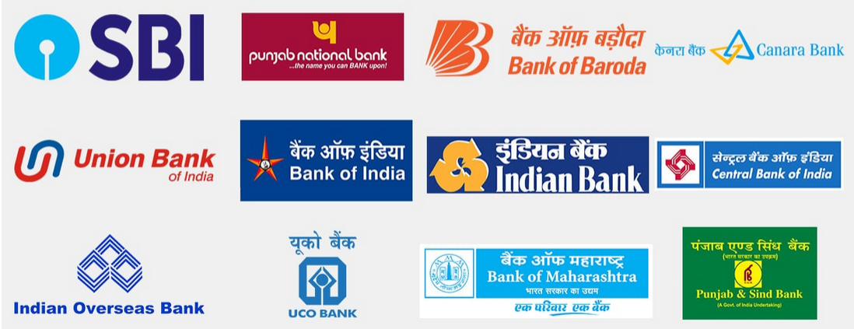
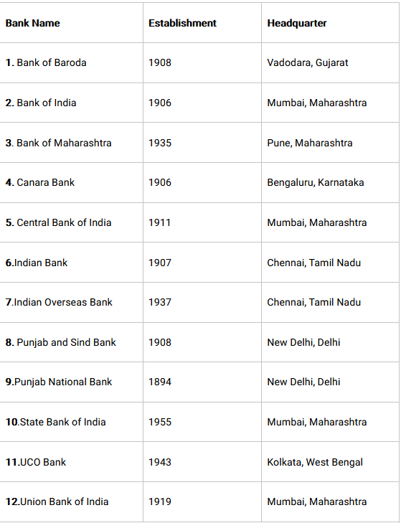


.
What are Public Sector Banks? The "public sector banks" are those banks where greater parts(>50%) of stake or equity are held by the government. Also k/w as Public Sector Undertakings.
PUBLIC SECTOR BANKS
Characteristics of Public Sector Banks:
1. State Ownership:
Public undertakings are fully owned by the Government or some public authority. For example, Reserve Bank of India is owned by the Central Govern­ment while Delhi Transport Corporation is owned by the Government of Delhi State.
ADVERTISEMENTS:
2. Government Control:
The ultimate control of a public sector undertaking lies with the Government.
3. Service Motive:
The primary objective of a public sector undertaking is to render service to the public at large. In order to serve the public, it may even incur loss. For example, the Food Corporation of India provides food grains to the public at subsidised prices.
ADVERTISEMENTS:
4. State Financing:
The Government provides the capital and funds through appropria­tions from its budget. The government may also provide loans from time to time from the State exchequer.
5. Bureaucratic Management:
The management of public sector undertakings is bureau­cratic in the sense that their operations are governed by certain rules and regulations prescribed by the Government.
ADVERTISEMENTS:
6. Public Accountability:
Public sector undertakings are accountable to the public at large for their performance and results. The annual audit of these undertakings is con­ducted by the Comptroller and Auditor General of India. Moreover, their annual reports are subject to discussion in the Parliament or the State legislature
Notes:
What are Public Sector Banks? & its characteristics

Slide 24


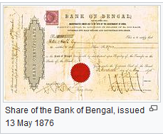
Characteristics of State Bank of India
SBI is unique in several respects and it enjoys a position of permanence as the agent of RBI wherever RBI has no branches.
It is the single largest bank in the country with large international presence, with a network of 191 overseas offices spread over 36 countries covering all the time zones.
All the 6 associates of SBI uses the same logo & they together constitutes as State Bank Group. Associates use “State Bank of” name followed by regional head.
SBI has often acted as guarantor to the Indian Government.
BI's non-banking subsidiaries include:
SBI Capital Markets Ltd
SBI Cards & Payments Services Pvt. Ltd. (SBICPSL)
SBI Life Insurance Company Limited
In March 2020, SBI acquired 48.2% of the shares of Yes Bank as part of RBI directed rescue deal.
SBI Its Associates
SBI stands for Stand Bank of India
Largest & Oldest commercial bank in Indian Sub-continent. SBI is one of the largest employers in the country with 300,000 employees
Currently, head-quartered at ‘State Bank Bhavan’
Nariman Point, Mumbai.
The roots of the State Bank of India rest in the first decade of 19th century, when the Bank of Calcutta ,later renamed the Bank of Bengal, was established on 2 June 1806
Currently SBI has over 24,000 branches and further 6500+ associate bank branches in India.
It is the only Indian bank to feature in the top 100 world banks in the Fortune Global 500 rating and various other rankings.
SBI acquired the control of seven banks in 1960. They were the seven regional banks of former Indian princely states. They were renamed, prefixing them with 'State Bank of'. These seven banks were State Bank of Bikaner and Jaipur (SBBJ), State Bank of Hyderabad (SBH), State Bank of Indore (SBN), State Bank of Mysore (SBM), State Bank of Patiala (SBP), State Bank of Saurashtra (SBS) and State Bank of Travancore (SBT).
Notes:
SBI & its associates group ; & its characteristics

Slide 25
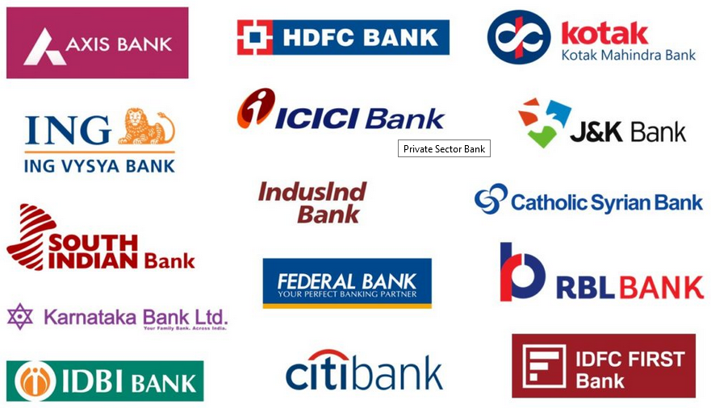
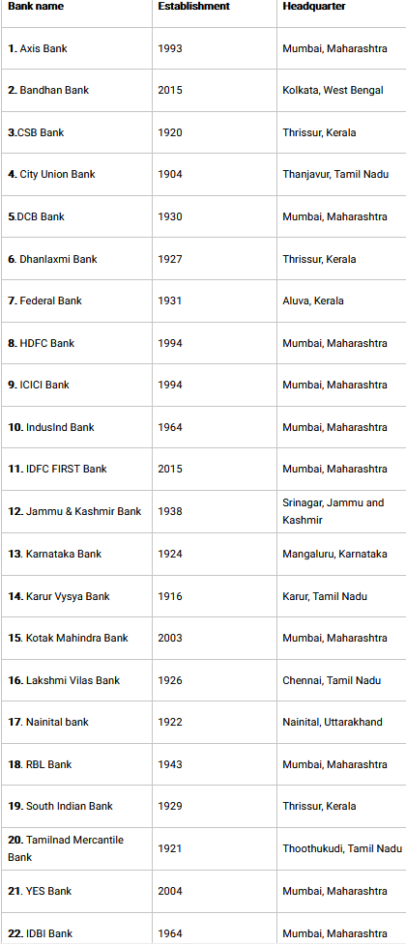
PRIVATE SECTOR BANKS
What are Private Sector Banks? The "private-sector banks" are those banks where greater parts(>50%) of stake or equity are held by the private shareholders and not by government.
In terms of revenue, HDFC Bank is the largest bank of the private sector in India. It has a total revenue of Rs. 816.02 billion (US$11 billion). ICICI Bank is in second place in terms of revenue. It has a revenue of Rs. 736.60 billion (US$10 billion).
Characteristics of Private Sector Banks:
Profit Motive The primary focus of companies in the private sector is making a profit. By operating within the regulations and compliances of the respective country, companies in the private sector typically manage to realize more profits compared to firms in the public sector. Additionally, profits provide reward for the risk taken and the required return on capital
Private ownership and control Private entrepreneurs are responsible for owning, controlling and managing the private sector. The management may be either by a single individual or by a group of people. When the ownership belongs to a single person, the private sector company is referred to as a sole proprietorship. Alternatively, a group of persons may jointly own a firm in the form of a cooperative society, partnership or a joint-stock company.
No state participation Private sector entities have less exposure to government interference. There is no participation by the state or central governments in the ownership and control of a private sector undertaking. The management of the private sector relies entirely on its owners. In the case of a sole proprietorship, the manager makes all of the decisions and acts on behalf of the company in legal matters. On the other hand, the management of a joint-stock company depends on a group of directors who are elected representatives of the shareholders.
Independent management The private sector obtains capital from its owners or shareholders. Different types of private sector undertakings have varied means of raising capital. A sole trader contributes capital for a sole proprietorship, and partners invest capital in case of a partnership. Alternatively, a joint-stock company raises capital through the issue of share and debentures (a type of long-term debt). Requesting loans for long- and short-term needs or funds is also another way the private sector raises capital.
Private financed Private sector companies receive very little financial support from the government unless they are large and significant for a country. Depending on the financial strength of the private sector, companies with stronger financials have better capacities to mobilize more funds from the market.
Work culture of employees The private sector has a competitive work culture, characterized by performance-based career growth and better compensation. Private sector companies strive to create the best work environment for their employees to maintain a competitive advantage over other firms in the private sector.
Notes:
What are Private Sector Banks? & its characteristics

Slide 26

FOREIGN BANKS
ELIGIBILITY
To function as a WOS there are several factors to be met.
A foreign bank is a
Type of International Bank that is obligated to follow the regulations of both the home and host countries.
Their loan limits are based on the parent bank’s capital,
Foreign banks can provide more loans than subsidiary banks.”
Foreign Banks are present in India either as representative offices or as branches.
A bank may choose to open foreign bank branches to meet the needs of multinational corporate customers.
There is an eligibility criterion on the basis of capital for a foreign bank to operate in India.
A Foreign Bank must have at least 5 billion rupees towards capital on establishment.
Also, a Foreign Bank must credit 18 % of net ANBC (‘adjusted net bank credit’ – which is total investment made by bank on non-governmental securities.) towards agricultural loans.
Proof of Economic stability and financial soundness to be provided by the bank
The bank must provide necessary documents to show the proper ownership.
The bank must be rated by any International rating agency.
Bank must have a risk management team
OPERATIONS
The Foreign banks can have different modes of operation in India.
BRANCH Mode or
SUBSIDIARY Mode which is known as WOS (Wholly owned Subsidiary).
They can either start the bank branches in the initial setup or later convert them to WOS.

Slide 27
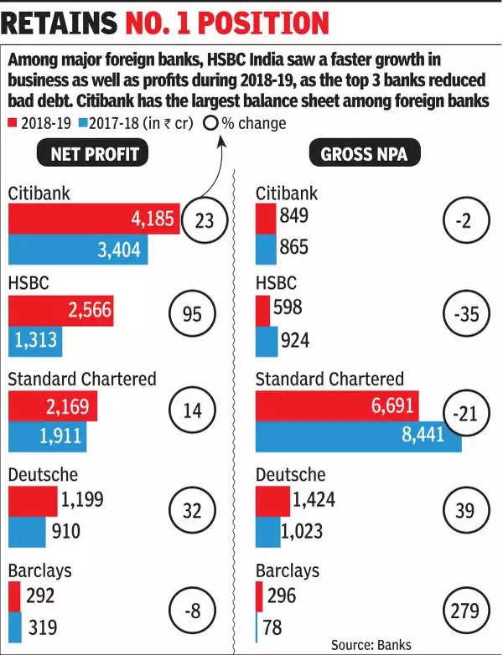
WHAT IS SINGLE MODE OF PRESENCE? By single mode of presence, it means that RBI allows either of the branch mode or a wholly owned subsidiary (WOS) mode in India
Some other policy guidelines of RBI towards foreign banks are as follows:
Foreign Banks have to adhere to mandated Capital Adequacy requirements as per Basel Standard.
Foreign Banks should have to meet minimum capital requirement of Rs. 5 billion.
Foreign Banks should need to maintain minimum CRAR at 10% Priority sector targets for foreign banks in India is 40%.
Foreign banks have to follow other norms as set by Reserve Bank of India.
MARKET Share
RBI Policy’s
Foreign Banks account for less than 1% of the total branch network in the country.
However, they account for approximately 7% of the total banking sector assets and around 11% of the profits.
In India, most of the foreign banks r Niche Players that’s why their business focus is more on Trade finance, external commercial borrowings, wholesale lending, investment banking and treasury services
RBI policy towards presence of foreign banks in India is based upon two cardinal principles
Reciprocity &
Single mode of presence.
WHAT IS RECIPROCITY? Reciprocity, it means that overseas banks are given near national treatment in India only if their home country allowed Indian banks to open branches there without much restrictions.

Slide 28
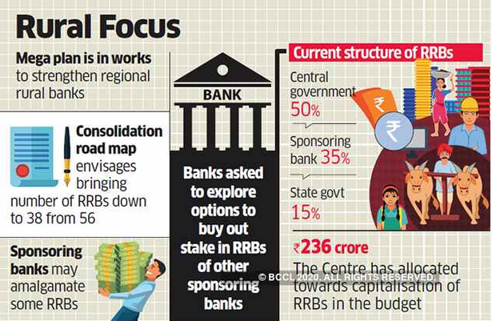
REGIONAL RURAL BANKS
RRBs were established on the recommendations of Narsimha Committee in 1975 under the provisions of the Ordinance promulgated on 26th September, 1975 and Regional Rural Banks Act, 1976.
The Objectives of Regional Rural Banks:
In view of the above preamble of the Act the objects and activities of RRBs can be briefed as under:
Bridging the credit gaps in rural areas.
To develop such measures which could restrict the outflow of rural deposits to urban areas.
To reduce regional imbalances and increase rural employment generation activities.
PURPOSE BEHIND RRBs
The Regional Rural Banks were established with a view to develop such type of banking institutions which could function as a commercial organization in rural areas.
For developing the rural economy
for the purpose of development of agriculture, trade, commerce, industry and other productive activities in the rural areas,
Credit and other facilities, particularly to small and marginal farmers, agricultural laborers, artisans and small entrepreneurs

Slide 29
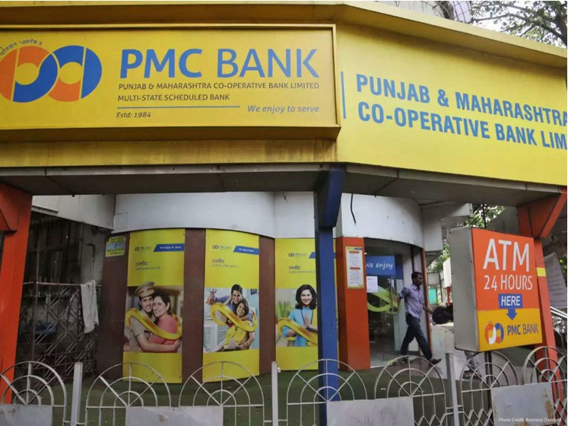
CO-OPERATIVE BANKS
Meaning of Co-operative Bank
Characteristics of a Co-Operative Bank
A co-operative bank is a financial entity which belongs to its members, who are at same time the owners & the customers of their bank.
Co-operative Banks generally provide their members with a wide range of banking & financial services like- Loans, deposits, Banking accounts etc.
Co-operative Banks are often created by persons belonging to the same local or professional community or sharing a common interest.
Co-operative Banks are registered under the Co-operative Societies Act, 1912 & governed by the Banking Regulations Act 1949 plus Banking Laws (co-operative societies) Act, 1965.
Customer Owned Entities In a cooperative bank, the needs of the clients meet the needs of the owners, since the members of the cooperative bank are both, i.e. the customer and the owner. As a result, the cooperative bank’s first goal is not to maximize profits but to provide the best products and services available to its members. Some cooperative banks operate only with their members, but most of them also allow non-member customers to benefit from their banking and financial services.
Democratic Member Control
Cooperative banks are owned and controlled by members, who democratically elect the board of directors. Members usually have the same voting rights, in accordance with the cooperative principle of “one person, one vote”.
Profit Allocation
In a cooperative bank, a significant portion of annual profits, profits or surpluses are generally allocated to build up reserves. Part of this benefit can also be distributed to members of the cooperative, with legal and legal limitations in most cases. In general, benefits are allocated to members through the employer’s dividend, which is related to the use of cooperative products and services by each member, or through an interest or dividend, which is related to the number of shares subscribed by each member.
On the basis of region
Credit co-operatives (or co-operative banks) are broadly classified into 2 types i.e.
Urban or
Rural co-operative banks

Slide 30
Central Co-operative Banks
These are federations of primary credit societies in a district and are of two types:
Those that have membership only in primary societies and
those that belong to companies and individuals.
2. The bank’s funds consist of equity capital, deposits, loans and bank overdrafts of state-run cooperative banks and joint ventures. These banks provide loans to associated companies within the limits of the company’s debt capacity. They also perform all the activities of a stock exchange.
TYPES OF
CO-OPERATIVE BANKS
State Co-operative Banks
The state cooperative bank is a federation of the central cooperative bank and acts as custodian of the cooperative banking structure in the State. Its funds are obtained from the social capital, deposits, loans and overdrafts of the Reserve Bank of India. State-owned cooperative banks lend money to cooperative central banks and then to primary companies and not directly to farmers.
Primary Co-operative Credit Society
The primary credit cooperative society is an association of borrowers and non-borrowers residing in a particular locality. The company’s funds derive from the share capital and members’ deposits and loans from cooperative central banks. The debt powers of members and society are fixed. Loans are granted to members for the purchase of livestock, fodder, fertilizers and pesticides
Urban Co-operative Bank
The term Urban Cooperatives Banks (UCB), although not formally defined, refers to primary cooperative banks located in urban and semi-urban areas. Until 1996, these banks were authorized to lend money for non-agricultural purposes only. This distinction is not satisfied today. These banks traditionally focused on communities, localities and workplace groups. Basically, they lend to small borrowers and businesses. Today, its operating environment has greatly increased.

Slide 31
Characteristics of Private Sector Banks:
Deal with a certain type of customers
Do not depend on the financial resources on individuals’ deposits
Depend on the capital and the issued bonds
Work on the sector-specific development
Implement the policies of the state
Organize work in a specific sector
Participate in the advancement of the development policies of the sector
SPECIALIZED Banks
The specialized banks are defined as those banks whose banking operations serves a specific type of economic activity, they concentrate mainly on financing specialized economic & social activities. Those Specialized activities may be small and cottage industries financing. Financing the rural asset less and landless people etc.
Some examples of Specialized Bank Bangladesh Krishi Bank, Bangladesh Development Bank Limited, Rajshahi Krishi Unnayan Bank and Grameen Bank (G.B.) of Bangladesh.
EXIM BANK
Export-Import Bank of India (EXIM Bank) is a specialized financial institution, wholly owned by Government of India, set up in 1982, for financing, facilitating and promoting foreign trade of India.
EXIM Bank extends Lines of Credit (LOCs) to overseas financial institutions, regional development banks, sovereign governments and other entities overseas, to enable buyers in those countries to import developmental and infrastructure projects, equipment's, goods and services from India, on deferred credit terms.
EXIM Bank has laid strong emphasis on enhancing project exports, the funding options for which have been enhanced with introduction of the Buyer's Credit-National Export Insurance Account (BC-NEIA) program.

Slide 32
National Bank For Agriculture and Rural Development (NABARD)
Due to the importance of Institutional credit in boosting rural economy, RBI at the insistence of GOI constituted a Committee to Review the Arrangements for Credit for Agriculture & Rural development(CRAFICARD). Committee was formed on March 30, 1979.
Committee’s report outlined the need for new organisational device for providing undivided attention, forceful direction & pointed focus to credit related issues linked with rural development.
After its recommendation NABARD was approved by the parliament through Act 61 of 1981.
Purpose of NABARD:
For financing agricultural and rural sectors. If a person is engaged in agriculture or other activities like handloom weaving, fishing, etc. NABARD can provide credit, both short-term and long-term, through regional rural banks
NABARD National Bank For Agriculture and Rural Development

Slide 33
Small Industries Development Bank of India (SIDBI)
Small Industries Development Bank of India (SIDBI)
Small Industries Development Bank of India(SIDBI) was set up on April 2,1990 under an act of Indian Parliament.
Purpose of SIDBI:
SIDBI acts as the Principal Financial Institution for the promotion, financing & development of the Micro, Small & Medium Enterprise (MSME) sector & also for co-ordination of the functions of the institutions engaged in similar activities.
The business domain of SIDBI consists of Micro, Small & Medium Enterprises(MSMEs), which contribute significantly to the national economy in terms of production, employment & exports.
MSME sector is an important pillar of Indian Economy as it contributes to the growth of Indian Economy with a vast network of around 5.1 crore units, creating employment of about 11.7 crore, manufacturing output & about 40 % of exports in terms of value, about 37% of GDP.
Financial support to MSMEs is provided by way of
Indirect/refinance to banks/financial institutions for onward lending to MSMEs
Direct finance in the niche areas like risk capital, sustainable finance, receivable financing, service sector financing, etc.

Slide 34
The main function of a Bank is to collect deposits from the public and lend those deposits for the development of Agriculture, Industry, Trade and Commerce. Bank pays interest at lower rates to the depositors and receives interests on loans and advances from them at higher rates.
So, there are 2 types of functions
Primary functions
Secondary functions
FUNCTIONS OF BANKING

Slide 35
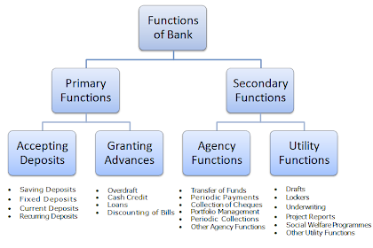
FUNCTIONS OF
BANK

Slide 36
The primary functions of a bank are also known as banking functions. They are the main functions of a bank.
1. Accepting Deposits
The bank collects deposits from the public. These deposits can be of different types, such as :-
Saving Deposits
Fixed Deposits
Current Deposits
Recurring Deposits
PRIMARY FUNCTIONS

Slide 37
a. Saving Deposits
This type of deposits encourages saving habit among the public. The rate of interest is low. At present it is about 4% p.a. Withdrawals of deposits are allowed subject to certain restrictions. This account is suitable to salary and wage earners. This account can be opened in single name or in joint names.
b. Fixed Deposits
Lump sum amount is deposited at one time for a specific period. Higher rate of interest is paid, which varies with the period of deposit. Withdrawals are not allowed before the expiry of the period. Those who have surplus funds go for fixed deposit.
PRIMARY FUNCTIONS

Slide 38
C. Current Deposits
This type of account is operated by businessmen. Withdrawals are freely allowed. No interest is paid. In fact, there are service charges. The account holders can get the benefit of overdraft facility.
d. Recurring Deposits
This type of account is operated by salaried persons and petty traders. A certain sum of money is periodically deposited into the bank. Withdrawals are permitted only after the expiry of certain period. A higher rate of interest is paid.
PRIMARY
FUNCTONS

Slide 39
2. Granting of Loans and Advances
The bank advances loans to the business community and other members of the public. The rate charged is higher than what it pays on deposits. The difference in the interest rates (lending rate and the deposit rate) is its profit.
The types of bank loans and advances are :-
Overdraft
Cash Credits
Loans
Discounting of Bill of Exchange
PRIMARY
FUNCTONS

Slide 40
a. Overdraft
This type of advances are given to current account holders. No separate account is maintained. All entries are made in the current account. A certain amount is sanctioned as overdraft which can be withdrawn within a certain period of time say three months or so. Interest is charged on actual amount withdrawn. An overdraft facility is granted against a collateral security. It is sanctioned to businessman and firms.
b. Cash Credits
The client is allowed cash credit upto a specific limit fixed in advance. It can be given to current account holders as well as to others who do not have an account with bank. Separate cash credit account is maintained. Interest is charged on the amount withdrawn in excess of limit. The cash credit is given against the security of tangible assets and / or guarantees. The advance is given for a longer period and a larger amount of loan is sanctioned than that of overdraft.
PRIMARY
FUNCTONS

Slide 41
c. Loans
It is normally for short term say a period of one year or medium term say a period of five years. Now-a-days, banks do lend money for long term. Repayment of money can be in the form of installments spread over a period of time or in a lumpsum amount. Interest is charged on the actual amount sanctioned, whether withdrawn or not. The rate of interest may be slightly lower than what is charged on overdrafts and cash credits. Loans are normally secured against tangible assets of the company.
d. Discounting of Bill of Exchange
The bank can advance money by discounting or by purchasing bills of exchange both domestic and foreign bills. The bank pays the bill amount to the drawer or the beneficiary of the bill by deducting usual discount charges. On maturity, the bill is presented to the drawee or acceptor of the bill and the amount is collected.
PRIMARY
FUNCTONS

Slide 42
The bank performs a number of secondary functions, also called as non-banking functions.
AGENCY FUNCTIONS
GENERAL UTILITY FUNCTIONS
SECONDARY
FUNCTIONS

Slide 43
1. Agency Functions
The bank acts as an agent of its customers. The bank performs a number of agency functions which includes :-
Transfer of Funds
Collection of Cheques
Periodic Payments
Portfolio Management
Periodic Collections
Other Agency Functions
SECONDARY
FUNCTIONS

Slide 44
a. Transfer of Funds
The bank transfer funds from one branch to another or from one place to another.
b. Collection of Cheques
The bank collects the money of the cheques through clearing section of its customers. The bank also collects money of the bills of exchange.
c. Periodic Payments
On standing instructions of the client, the bank makes periodic payments in respect of electricity bills, rent, etc.
SECONDARY
FUNCTIONS

Slide 45
d. Portfolio Management
The banks also undertakes to purchase and sell the shares and debentures on behalf of the clients and accordingly debits or credits the account. This facility is called portfolio management.
e. Periodic Collections
The bank collects salary, pension, dividend and such other periodic collections on behalf of the client.
f. Other Agency Functions
They act as trustees, executors, advisers and administrators on behalf of its clients. They act as representatives of clients to deal with other banks and institutions.
SECONDARY
FUNCTIONS

Slide 46
2. General Utility Functions
The bank also performs general utility functions, such as :-
Issue of Drafts, Letter of Credits, etc.
Locker Facility
Underwriting of Shares
Dealing in Foreign Exchange
Project Reports
Social Welfare Programmes
Other Utility Functions
SECONDARY
FUNCTIONS

Slide 47
a. Issue of Drafts and Letter of Credits
Banks issue drafts for transferring money from one place to another. It also issues letter of credit, especially in case of, import trade. It also issues travellers' cheques.
b. Locker Facility
The bank provides a locker facility for the safe custody of valuable documents, gold ornaments and other valuables.
c. Underwriting of Shares
The bank underwrites shares and debentures through its merchant banking division.
d. Dealing in Foreign Exchange
The commercial banks are allowed by RBI to deal in foreign exchange.
SECONDARY
FUNCTIONS

Slide 48
e. Project Reports
The bank may also undertake to prepare project reports on behalf of its clients.
f. Social Welfare Programmes
It undertakes social welfare programmes, such as adult literacy programmes, public welfare campaigns, etc.
g. Other Utility Functions
It acts as a referee to financial standing of customers. It collects creditworthiness information about clients of its customers. It provides market information to its customers, etc. It provides travellers' cheque facility.
SECONDARY
FUNCTIONS

Slide 49
THANKYOU

